Slide 1
Conda Virtual
Environments
Introduction

Slide 2
Virtual Environments

Slide 3
What are virtual environments?

Slide 4
What are virtual environments?
Basically: isolated instances of software (the software is stored in dedicated folders)

Slide 5
What are virtual environments?
Basically: isolated instances of software (the software is stored in dedicated folders)
Normally, software is installed directly on the operating system
libs & deps
Host OS
Hardware

Slide 6
What are virtual environments?
Basically: isolated instances of software (the software is stored in dedicated folders)
Normally, software is installed directly on the operating system
Virtual environments allow you to install software that will only be used while within the environment.
libs & deps
VEnv. 1
VEnv. 2
libs & deps
libs & deps
libs & deps
Host OS
Hardware
Host OS
Hardware

Slide 7
What are virtual environments?
Basically: isolated instances of software (the software is stored in dedicated folders)
Normally, software is installed directly on the operating system
Virtual environments allow you to install software that will only be used while within the environment.
libs & deps
VEnv. 1
VEnv. 2
libs & deps
libs & deps
libs & deps
Host OS
While outside the virtual environment, normal system software is used
Hardware
Host OS
Hardware

Slide 8
Why you should virtual environments

Slide 9

Why you should virtual environments
Manage package dependencies:
VEnv. 1
VEnv. 2
Python 2.7
Python 3.6
VEnv. 3
Python 3.10

Slide 10
Why you should virtual environments
Manage package dependencies:
Often different projects will require different version of the same software.
Using virtual environments allows you the install the version you need for your project.
VEnv. 1
VEnv. 2
Python 2.7
Python 3.6
VEnv. 3
Python 3.10

Slide 11

Why you should virtual environments
Manage package dependencies:
Easier reproducibility:.
Often different projects will require different version of the same software.
Using virtual environments allows you the install the version you need for your project.
VEnv. 1
VEnv. 2
VEnv. 1
libs & deps
Python 2.7
Python 3.6
VEnv. 1
Host OS - 1
libs & deps
VEnv. 3
Hardware - 1
Host OS - 2
Python 3.10
Hardware - 2

Slide 12
Why you should virtual environments
Manage package dependencies:
Easier reproducibility:.
Often different projects will require different version of the same software.
Using virtual environments allows you the install the version you need for your project.
By keeping all your software for a specific project within a virtual environment, it is easier to keep track of required software and specific versions. This will make it easier to remake the environment.
VEnv. 1
VEnv. 2
VEnv. 1
libs & deps
Python 2.7
Python 3.6
VEnv. 1
Host OS - 1
libs & deps
VEnv. 3
Hardware - 1
Host OS - 2
Python 3.10
Hardware - 2

Slide 13


Why you should virtual environments
Manage package dependencies:
Easier reproducibility:.
Keep OS software lean & clean:.
Often different projects will require different version of the same software.
Using virtual environments allows you the install the version you need for your project.
By keeping all your software for a specific project within a virtual environment, it is easier to keep track of required software and specific versions. This will make it easier to remake the environment.
VEnv. 1
VEnv. 2
VEnv. 1
libs & deps
Python 2.7
Python 3.6
VEnv. 1
Host OS - 1
libs & deps
Host OS
Host OS
VEnv. 3
Hardware - 1
Hardware
Hardware
Host OS - 2
Python 3.10
Hardware - 2

Slide 14
Why you should virtual environments
Manage package dependencies:
Easier reproducibility:.
Keep OS software lean & clean:.
Often different projects will require different version of the same software.
Using virtual environments allows you the install the version you need for your project.
By keeping all your software for a specific project within a virtual environment, it is easier to keep track of required software and specific versions. This will make it easier to remake the environment.
Installing different versions of the same software on your OS can get messy and have unexpected consequences and installing everything directly on your OS can cause the system to get bloated.
VEnv. 1
VEnv. 2
VEnv. 1
libs & deps
Python 2.7
Python 3.6
VEnv. 1
Host OS - 1
libs & deps
Host OS
Host OS
VEnv. 3
Hardware - 1
Hardware
Hardware
Host OS - 2
Python 3.10
Hardware - 2

Slide 15
Why you should virtual environments
Best practice
For every project, create a corresponding virtual environment
Manage package dependencies:
Easier reproducibility:.
Keep OS software lean & clean:.
Often different projects will require different version of the same software.
Using virtual environments allows you the install the version you need for your project.
By keeping all your software for a specific project within a virtual environment, it is easier to keep track of required software and specific versions. This will make it easier to remake the environment.
Installing different versions of the same software on your OS can get messy and have unexpected consequences and installing everything directly on your OS can cause the system to get bloated.
VEnv. 1
VEnv. 2
VEnv. 1
libs & deps
Python 2.7
Python 3.6
VEnv. 1
Host OS - 1
libs & deps
Host OS
Host OS
VEnv. 3
Hardware - 1
Hardware
Hardware
Host OS - 2
Python 3.10
Hardware - 2

Slide 16
Conda & Mamba

Slide 17
What is conda/mamba?

Slide 18

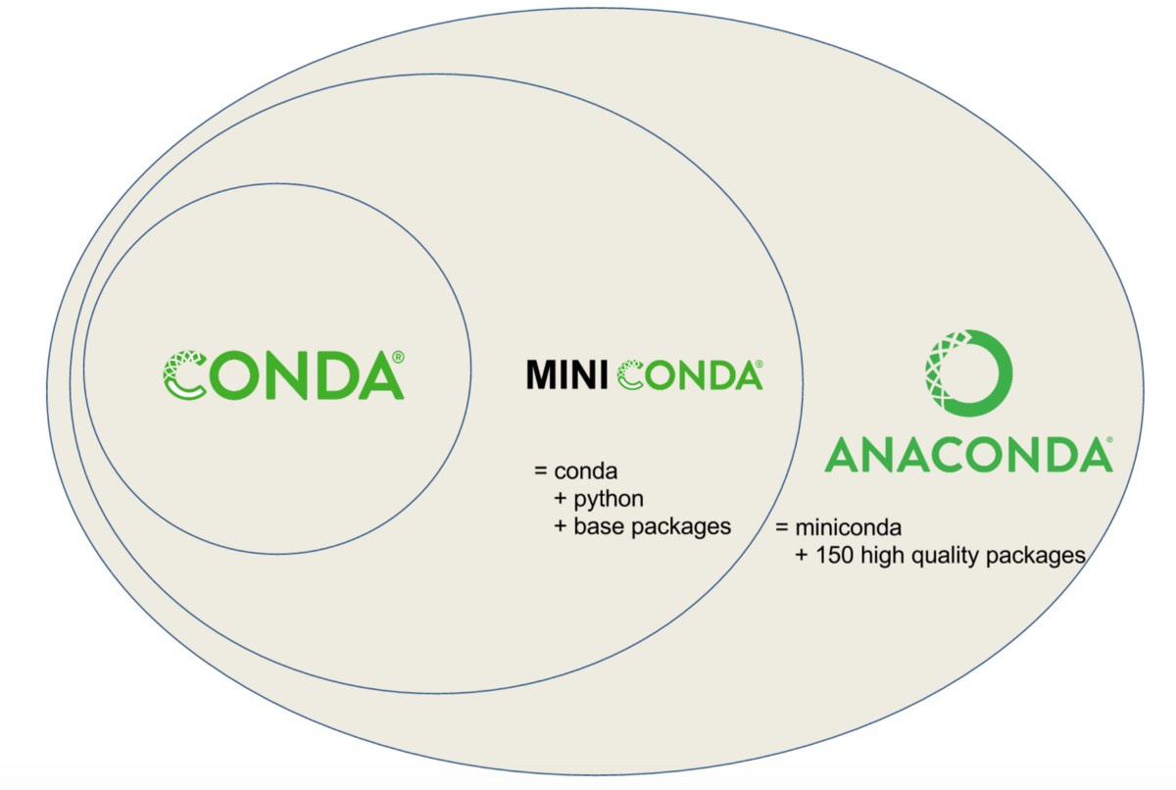
What is conda/mamba?
conda is one of the most popular python package & environment management tools for data scientist.

Slide 19

What is conda/mamba?
conda is one of the most popular python package & environment management tools for data scientist.
Mamba is a reimplementation of the conda package manager in C++ (meaning it’s much faster).
However, it cannot to do EVERYTHING conda can.

Slide 20
What is conda/mamba?
conda is one of the most popular python package & environment management tools for data scientist.
Mamba is a reimplementation of the conda package manager in C++ (meaning it’s much faster).
However, it cannot to do EVERYTHING conda can.
General rule:
Use ‘mamba’ for installing software (this includes creating new environments)
Use ‘conda’ for everything else

Slide 21
Why you should use conda/mamba

Slide 22
Why you should use conda/mamba
Can install python packages

Slide 23
Why you should use conda/mamba
Can install python packages
Can install non-python packages

Slide 24
Why you should use conda/mamba
Can install python packages
Can install non-python packages
Can use pip

Slide 25
Why you should use conda/mamba
Can install python packages
Can install non-python packages
Can use pip
Can create virtual environments

Slide 26
Why you should use conda/mamba
Can install python packages
Can install non-python packages
Can use pip
Can create virtual environments
Checks dependencies

Slide 27
Setting up conda & mamba

Slide 28
Installing conda & mamba

Slide 29
Installing conda & mamba
1. Install conda by follow installation instructions here:
https://conda.io/projects/conda/en/latest/user-guide/install/index.html
You will be told asked to download a file and run it

Slide 30
Installing conda & mamba
1. Install conda by follow installation instructions here:
https://conda.io/projects/conda/en/latest/user-guide/install/index.html
You will be told asked to download a file and run it
Hints
I recommend (and use) ‘miniconda’ over ‘anaconda’ because it is more lightweight. Anaconda is a much larger file with many pre-installed packages that you may not need.

Slide 31
Installing conda & mamba
1. Install conda by follow installation instructions here:
https://conda.io/projects/conda/en/latest/user-guide/install/index.html
You will be told asked to download a file and run it
Hints
I recommend (and use) ‘miniconda’ over ‘anaconda’ because it is more lightweight. Anaconda is a much larger file with many pre-installed packages that you may not need.
If you are using Windows, I recommend installing WSL (Windows Subsystem for Linux) with Ubuntu and installing conda (Linux_ on WSL Ubuntu. Instructions for setting up WSL can be found here: https://ubuntu.com/wsl

Slide 32
Installing conda & mamba
1. Install conda by follow installation instructions here:
https://conda.io/projects/conda/en/latest/user-guide/install/index.html
You will be told asked to download a file and run it
2. After installing conda, install mamba by running:
conda install mamba -n base -c conda-forge
More information on mamba can be found here:
https://github.com/mamba-org/mamba
Hints
I recommend (and use) ‘miniconda’ over ‘anaconda’ because it is more lightweight. Anaconda is a much larger file with many pre-installed packages that you may not need.
If you are using Windows, I recommend installing WSL (Windows Subsystem for Linux) with Ubuntu and installing conda (Linux_ on WSL Ubuntu. Instructions for setting up WSL can be found here: https://ubuntu.com/wsl

Slide 33
Setup Hints

Slide 34
Setup Hints
In general, you should never install anything in your ‘base’ environment (installing mamba is an exception).

Slide 35
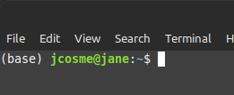
Setup Hints
In general, you should never install anything in your ‘base’ environment (installing mamba is an exception).
By default, after installing conda, the ‘base’ environment will always be active when you open a terminal window.

Slide 36
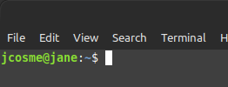
Setup Hints
In general, you should never install anything in your ‘base’ environment (installing mamba is an exception).
By default, after installing conda, the ‘base’ environment will always be active when you open a terminal window.
You can change this setting by running the following:
conda config --set auto_activate_base false

Slide 37
Setup Hints
In general, you should never install anything in your ‘base’ environment (installing mamba is an exception).
Conda installs from ‘channels.’
By default, after installing conda, the ‘base’ environment will always be active when you open a terminal window.
You can change this setting by running the following:
conda config --set auto_activate_base false

Slide 38
Setup Hints
In general, you should never install anything in your ‘base’ environment (installing mamba is an exception).
Conda installs from ‘channels.’
If you are going to use GPUs, you might also want to add the NVIDIA channel and the Rapids.ai channel.
By default, after installing conda, the ‘base’ environment will always be active when you open a terminal window.
conda config --add channels nvidia
conda config --add channels rapidsai
You can change this setting by running the following:
conda config --set auto_activate_base false

Slide 39
Setup Hints
In general, you should never install anything in your ‘base’ environment (installing mamba is an exception).
Conda installs from ‘channels.’
If you are going to use GPUs, you might also want to add the NVIDIA channel and the Rapids.ai channel.
By default, after installing conda, the ‘base’ environment will always be active when you open a terminal window.
conda config --add channels nvidia
conda config --add channels rapidsai
The most popular channel is ‘conda-forge.’ It is a good idea to always add this channel to conda.
You can change this setting by running the following:
conda config --add channels conda-forge
conda config --set auto_activate_base false

Slide 40
Setup Hints
In general, you should never install anything in your ‘base’ environment (installing mamba is an exception).
Conda installs from ‘channels.’
If you are going to use GPUs, you might also want to add the NVIDIA channel and the Rapids.ai channel.
By default, after installing conda, the ‘base’ environment will always be active when you open a terminal window.
conda config --add channels nvidia
conda config --add channels rapidsai
The most popular channel is ‘conda-forge.’ It is a good idea to always add this channel to conda.
You can change this setting by running the following:
conda config --add channels conda-forge
conda config --set auto_activate_base false
Note: the ‘--add’ flag will, in addition to adding the channel, make it the highest priority channel.
Since we want the highest priority channel to be ‘conda-forge’ we should add it last.

Slide 41
Overview

Slide 42
To use:

Slide 43
To use:
1. Create an environment

Slide 44
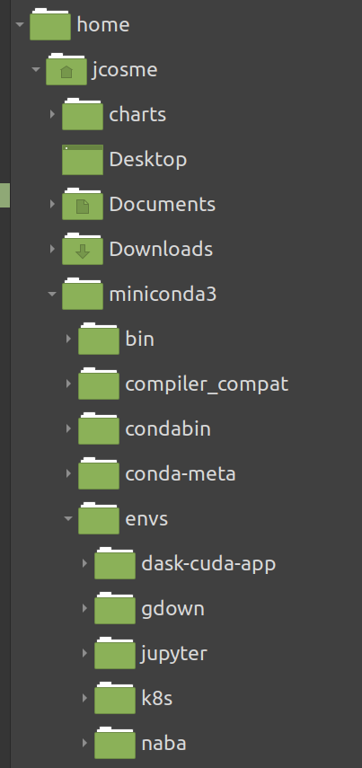
To use:
1. Create an environment
Conda will store your environments in the ‘envs’ folder, within the conda software folder (called ‘miniconda3’ in my case).

Slide 45
To use:
1. Create an environment
2. Activate the environment
Conda will store your environments in the ‘envs’ folder, within the conda software folder (called ‘miniconda3’ in my case).
In order to install packages or use an environment, it must be activated first

Slide 46
To use:
1. Create an environment
2. Activate the environment
Conda will store your environments in the ‘envs’ folder, within the conda software folder (called ‘miniconda3’ in my case).
In order to install packages or use an environment, it must be activated first
3. Install your packages
Install any software or packages you want within the activated environment

Slide 47
To use:
1. Create an environment
2. Activate the environment
Conda will store your environments in the ‘envs’ folder, within the conda software folder (called ‘miniconda3’ in my case).
In order to install packages or use an environment, it must be activated first
3. Install your packages
Install any software or packages you want within the activated environment
4. Use the environment
Run your scripts or start your applications from within the activated environment

Slide 48
The 3 main commands:

Slide 49
The 3 main commands:
1. To create an environment, use: mamba create
mamba create -n {your-env-name}

Slide 50
The 3 main commands:
1. To create an environment, use: mamba create
mamba create -n {your-env-name}
2. To activate an environment, use:
conda activate
conda activate {your-env-name}

Slide 51
The 3 main commands:
1. To create an environment, use: mamba create
mamba create -n {your-env-name}
2. To activate an environment, use:
conda activate
conda activate {your-env-name}
3. To install packages in an active environment, use: mamba install
mamba install {package-name}

Slide 52
The 3 main commands:
1. To create an environment, use: mamba create
mamba create -n {your-env-name}
2. To activate an environment, use:
conda activate
conda activate {your-env-name}
3. To install packages in an active environment, use: mamba install
mamba install {package-name}
To install packages in a specific, non-active environment, add the ‘-n’ flag, followed by the environment name
mamba install -n {an-env-name} {package-name}

Slide 53
Other important commands:

Slide 54
Other important commands:
To deactivate an environment, use: conda deactivate
conda deactivate

Slide 55
Other important commands:
To deactivate an environment, use: conda deactivate
conda deactivate
To view all environments, use: conda env list
conda env list

Slide 56
Other important commands:
To deactivate an environment, use: conda deactivate
conda deactivate
To view all environments, use: conda env list
conda env list
To delete an environment, use: conda env remove
conda env remove -n {your-env-name}

Slide 57
Note on creation, versions and channels:

Slide 58
Note on creation, versions and channels:
You can install packages when creating a new environment by specifying the package name(s) afterwards
mamba create -n {your-env-name}
mamba create -n {your-env-name} {package-name-1} {package-name-2}

Slide 59
Note on creation, versions and channels:
You can install packages when creating a new environment by specifying the package name(s) afterwards
mamba create -n {your-env-name}
mamba create -n {your-env-name} {package-name-1} {package-name-2}
You can install a specific version by adding the ‘=‘ sign, followed by the version (no spaces)
mamba install {package-name}
mamba install -n {an-env-name} {package-name}

Slide 60
Note on creation, versions and channels:
You can install packages when creating a new environment by specifying the package name(s) afterwards
mamba create -n {your-env-name}
mamba create -n {your-env-name} {package-name-1} {package-name-2}
You can install a specific version by adding the ‘=‘ sign, followed by the version (no spaces)
mamba create -n {your-env-name} {package-name}={version}
mamba install {package-name}={version}
mamba install {package-name}
mamba install -n {an-env-name} {package-name}

Slide 61
Note on creation, versions and channels:
You can install packages when creating a new environment by specifying the package name(s) afterwards
mamba create -n {your-env-name}
mamba create -n {your-env-name} {package-name-1} {package-name-2}
You can install a specific version by adding the ‘=‘ sign, followed by the version (no spaces)
mamba create -n {your-env-name} {package-name}={version}
mamba install {package-name}={version}
You can install from a specific channel by using the ‘-c’ flag, followed by the channel
mamba install {package-name}
mamba create -n {your-env-name} -c {a-channel} {package-name}
mamba install -c {a-channel} {package-name}
mamba install -n {an-env-name} {package-name}

Slide 62
Note on creation, versions and channels:
You can install packages when creating a new environment by specifying the package name(s) afterwards
mamba create -n {your-env-name}
mamba create -n {your-env-name} {package-name-1} {package-name-2}
You can install a specific version by adding the ‘=‘ sign, followed by the version (no spaces)
mamba create -n {your-env-name} {package-name}={version}
mamba install {package-name}={version}
You can install from a specific channel by using the ‘-c’ flag, followed by the channel
mamba install {package-name}
mamba create -n {your-env-name} -c {a-channel} {package-name}
mamba install -c {a-channel} {package-name}
Here are a couple of examples:
mamba install -n {an-env-name} {package-name}
mamba create -n my-proj -c conda-forge python=3.8 pandas
mamba install -c conda-forge python=3.8 pandas

Slide 63
Other important commands:

Slide 64
Other important commands:
To deactivate an environment, use: conda deactivate
conda deactivate
To view all environments, use: conda env list
conda env list
To delete an environment, use: conda env remove
conda env remove -n {your-env-name}

Slide 65
Other important commands:
To deactivate an environment, use: conda deactivate
To remove packages, use: mamba uninstall
conda deactivate
mamba uninstall {package-name}
To view all environments, use: conda env list
conda env list
To delete an environment, use: conda env remove
conda env remove -n {your-env-name}

Slide 66
Other important commands:
To deactivate an environment, use: conda deactivate
To remove packages, use: mamba uninstall
conda deactivate
mamba uninstall {package-name}
To view all environments, use: conda env list
To export an active environment**, use: mamba env export
conda env list
mamba env export > {env-export-file-name}
To delete an environment, use: conda env remove
conda env remove -n {your-env-name}

Slide 67
Other important commands:
To deactivate an environment, use: conda deactivate
To remove packages, use: mamba uninstall
conda deactivate
mamba uninstall {package-name}
To view all environments, use: conda env list
To export an active environment**, use: mamba env export
conda env list
mamba env export > {env-export-file-name}
To delete an environment, use: conda env remove
To re-create an exported environment**, use: mamba env create
conda env remove -n {your-env-name}
mamba env create -f {env-export-file-name}

Slide 68
Other important commands:
To deactivate an environment, use: conda deactivate
To remove packages, use: mamba uninstall
conda deactivate
mamba uninstall {package-name}
To view all environments, use: conda env list
To export an active environment**, use: mamba env export
conda env list
mamba env export > {env-export-file-name}
To delete an environment, use: conda env remove
To re-create an exported environment**, use: mamba env create
conda env remove -n {your-env-name}
mamba env create -f {env-export-file-name}
**More information on ‘exporting’ to follow

Slide 69
Exporting & recreating environments

Slide 70
What is exporting conda environments and why do it?

Slide 71
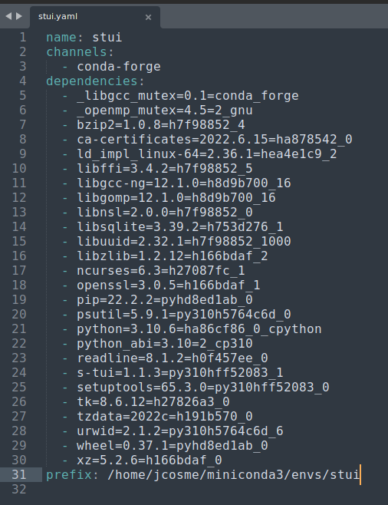
What is exporting conda environments and why do it?
Exporting an environment creates a file (yaml) that lists all the packages and version that are installed in that environment. It will also save the channels, and any environment variables saved to the environment.

Slide 72
What is exporting conda environments and why do it?
Exporting an environment creates a file (yaml) that lists all the packages and version that are installed in that environment. It will also save the channels, and any environment variables saved to the environment.
This file can be saved to a repository of your project code for others to be able to easily create an environment that will successfully run your code.

Slide 73
What is exporting conda environments and why do it?
Exporting an environment creates a file (yaml) that lists all the packages and version that are installed in that environment. It will also save the channels, and any environment variables saved to the environment.
This file can be saved to a repository of your project code for others to be able to easily create an environment that will successfully run your code.
Can also be used by you to recreate the environment, in the case where you have not touched the code for years and need to once again work on it.

Slide 74
What is exporting conda environments and why do it?
Exporting an environment creates a file (yaml) that lists all the packages and version that are installed in that environment. It will also save the channels, and any environment variables saved to the environment.
This file can be saved to a repository of your project code for others to be able to easily create an environment that will successfully run your code.
Can also be used by you to recreate the environment, in the case where you have not touched the code for years and need to once again work on it.
Can also be used in docker image creation whenever you need to containerize your code.

Slide 75
What is exporting conda environments and why do it?
Exporting an environment creates a file (yaml) that lists all the packages and version that are installed in that environment. It will also save the channels, and any environment variables saved to the environment.
This file can be saved to a repository of your project code for others to be able to easily create an environment that will successfully run your code.
Can also be used by you to recreate the environment, in the case where you have not touched the code for years and need to once again work on it.
Can also be used in docker image creation whenever you need to containerize your code.
Allows you to remove the conda environment (and free up space) once you are finished working on the project.

Slide 76
Export conda environments

Slide 77
Export conda environments
When exporting conda environments, the yaml file will be created in the current directory.

Slide 78
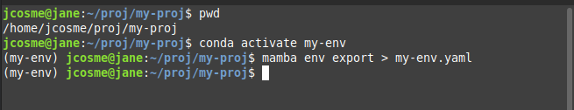
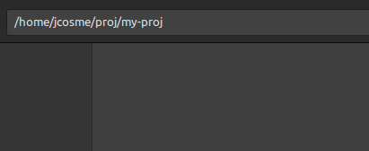
Export conda environments
When exporting conda environments, the yaml file will be created in the current directory.
In our example, we start in the following directory:
/home/jcosme/proj/my-proj

Slide 79
Export conda environments
When exporting conda environments, the yaml file will be created in the current directory.
1. Activate the conda environment
conda activate {your-env-name}
In our example, we start in the following directory:
/home/jcosme/proj/my-proj

Slide 80
Export conda environments
When exporting conda environments, the yaml file will be created in the current directory.
1. Activate the conda environment
conda activate {your-env-name}
In our example, we start in the following directory:
/home/jcosme/proj/my-proj
2. Run the export command (use mamba)
mamba env export > {env-export-file-name}

Slide 81
Export conda environments
When exporting conda environments, the yaml file will be created in the current directory.
1. Activate the conda environment
conda activate {your-env-name}
In our example, we start in the following directory:
/home/jcosme/proj/my-proj
2. Run the export command (use mamba)
mamba env export > {env-export-file-name}
1
2

Slide 82
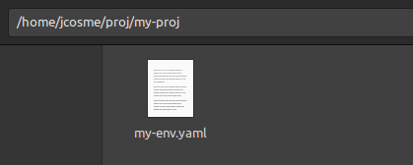
Export conda environments
When exporting conda environments, the yaml file will be created in the current directory.
1. Activate the conda environment
conda activate {your-env-name}
In our example, we start in the following directory:
/home/jcosme/proj/my-proj
2. Run the export command (use mamba)
mamba env export > {env-export-file-name}
1
2

Slide 83
Export conda environments
When exporting conda environments, the yaml file will be created in the current directory.
1. Activate the conda environment
conda activate {your-env-name}
In our example, we start in the following directory:
/home/jcosme/proj/my-proj
2. Run the export command (use mamba)
mamba env export > {env-export-file-name}
1
2
3. (optional) deactivate and delete environment

Slide 84
Recreate conda environments

Slide 85
Recreate conda environments
1. Start in the directory with the yaml file

Slide 86
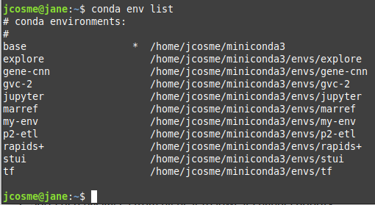
Recreate conda environments
1. Start in the directory with the yaml file
2. Make sure the environment name doesn’t already exist

Slide 87
Recreate conda environments
1. Start in the directory with the yaml file
3. Run the following command (use mamba)
mamba env create -f {env-export-file-name}
2. Make sure the environment name doesn’t already exist

Slide 88
Recreate conda environments
1. Start in the directory with the yaml file
3. Run the following command (use mamba)
mamba env create -f {env-export-file-name}
The key is the ‘-f’ flag, which tells conda to create an environment from a file.
2. Make sure the environment name doesn’t already exist

Slide 89
Recreate conda environments
1. Start in the directory with the yaml file
3. Run the following command (use mamba)
mamba env create -f {env-export-file-name}
The key is the ‘-f’ flag, which tells conda to create an environment from a file.
2. Make sure the environment name doesn’t already exist
If you want to specify a name, use the ‘-n’:
mamba env create -n {your-env-name} -f {env-export-file-name}

Slide 90
Recreate conda environments
1. Start in the directory with the yaml file
3. Run the following command (use mamba)
mamba env create -f {env-export-file-name}
The key is the ‘-f’ flag, which tells conda to create an environment from a file.
2. Make sure the environment name doesn’t already exist
If you want to specify a name, use the ‘-n’:
mamba env create -n {your-env-name} -f {env-export-file-name}
In our example, I could use the following to create the ‘my-env’ environment
mamba env create -f my-env.yaml

Slide 91
Miscellaneous

Slide 92
Using pip

Slide 93
Using pip
The preferred way of installing is using mamba/conda.

Slide 94
Using pip
The preferred way of installing is using mamba/conda.
Sometimes mamba/conda don’t have the package version you need.

Slide 95
Using pip
The preferred way of installing is using mamba/conda.
Sometimes mamba/conda don’t have the package version you need.
In these cases, you can use pip

Slide 96
Using pip
The preferred way of installing is using mamba/conda.
Sometimes mamba/conda don’t have the package version you need.
In these cases, you can use pip
However, if you must you pip:

Slide 97
Using pip
The preferred way of installing is using mamba/conda.
Sometimes mamba/conda don’t have the package version you need.
In these cases, you can use pip
However, if you must you pip:
Use mamba/conda to install everything that you can

Slide 98
Using pip
The preferred way of installing is using mamba/conda.
Sometimes mamba/conda don’t have the package version you need.
In these cases, you can use pip
However, if you must you pip:
Use mamba/conda to install everything that you can
Use pip at the end

Slide 99
Skip installation confirmation

Slide 100
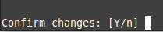
Skip installation confirmation
By default, when installing mamba/conda packages, the user will be prompted to confirm the installs

Slide 101
Skip installation confirmation
By default, when installing mamba/conda packages, the user will be prompted to confirm the installs
You can skip this confirmation by adding the ‘-y’ flag at the end of an install command
mamba install {package-name} -y
mamba install -c {a-channel} {package-name}={version} -y

Slide 102
Error recreating environment from yaml file

Slide 103
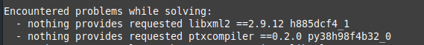
Error recreating environment from yaml file
Sometime, when recreating an environment from a yaml file, you might run into an error that looks like this:

Slide 104
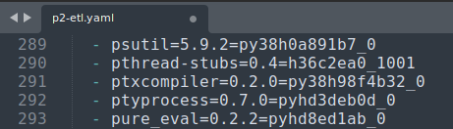
Error recreating environment from yaml file
Sometime, when recreating an environment from a yaml file, you might run into an error that looks like this:
In these situations, open the yaml file, locate the line with the package…

Slide 105
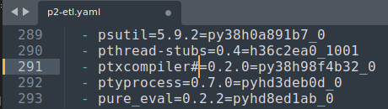
Error recreating environment from yaml file
Sometime, when recreating an environment from a yaml file, you might run into an error that looks like this:
In these situations, open the yaml file, locate the line with the package…
…and comment out anything beyond the name of the package.

Slide 106
Error recreating environment from yaml file
Sometime, when recreating an environment from a yaml file, you might run into an error that looks like this:
In these situations, open the yaml file, locate the line with the package…
…and comment out anything beyond the name of the package.
This will allow mamba/conda to automatically find a suitable version of the package.

Slide 107
Conda environment variables

Slide 108
Conda environment variables
It is possible to set environment variables in an activated environment, using the format:
conda env config vars set {env-var-name}={env-var-value}
For example:
conda env config vars set TF_FORCE_GPU_ALLOW_GROWTH=true

Slide 109
Conda environment variables
It is possible to set environment variables in an activated environment, using the format:
conda env config vars set {env-var-name}={env-var-value}
For example:
conda env config vars set TF_FORCE_GPU_ALLOW_GROWTH=true
To view variables in an activated environment, run:
conda env config vars list

Slide 110
Conda environment variables
It is possible to set environment variables in an activated environment, using the format:
conda env config vars set {env-var-name}={env-var-value}
For example:
conda env config vars set TF_FORCE_GPU_ALLOW_GROWTH=true
To view variables in an activated environment, run:
conda env config vars list
To remove environment variables in an activated environment, use this format:
conda env config vars unset {env-var-name}
For example:
conda env config vars unset TF_FORCE_GPU_ALLOW_GROWTH

Slide 111
Conda environment variables
It is possible to set environment variables in an activated environment, using the format:
conda env config vars set {env-var-name}={env-var-value}
For example:
conda env config vars set TF_FORCE_GPU_ALLOW_GROWTH=true
To view variables in an activated environment, run:
conda env config vars list
To remove environment variables in an activated environment, use this format:
conda env config vars unset {env-var-name}
For example:
conda env config vars unset TF_FORCE_GPU_ALLOW_GROWTH
Set environment variables will be included in yaml file during exports, and will be set when recreating environments from yaml files.

Slide 112
Thank you!

